Slide 1
Project Forest

Slide 2
What is the general theme?
Forest environment
Tackling deforestation

Slide 3
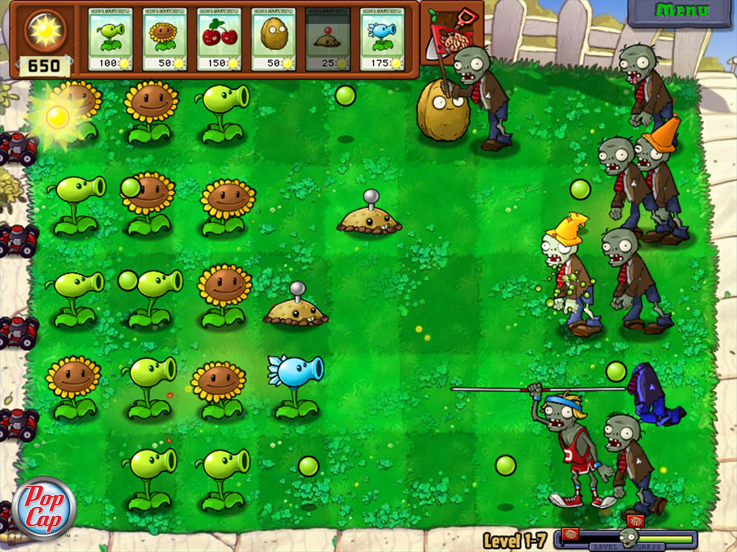
What will the gameplay be?
Tower defence
Enemies will spawn in centre of map
Have to defend from both sides.
Spawn with leaves, start with 3 leaves.
Overall inspired by PvZ

Slide 4
What’s the story?
People are trying to destroy the forest
Up to nature to fight back

Slide 5
UI Design
Nature cards appear either left or right (player’s preference)
Pause menu appears top right
Speed up top right

